Slide 1

Jaipur Airport
Static Lightbox

Slide 2
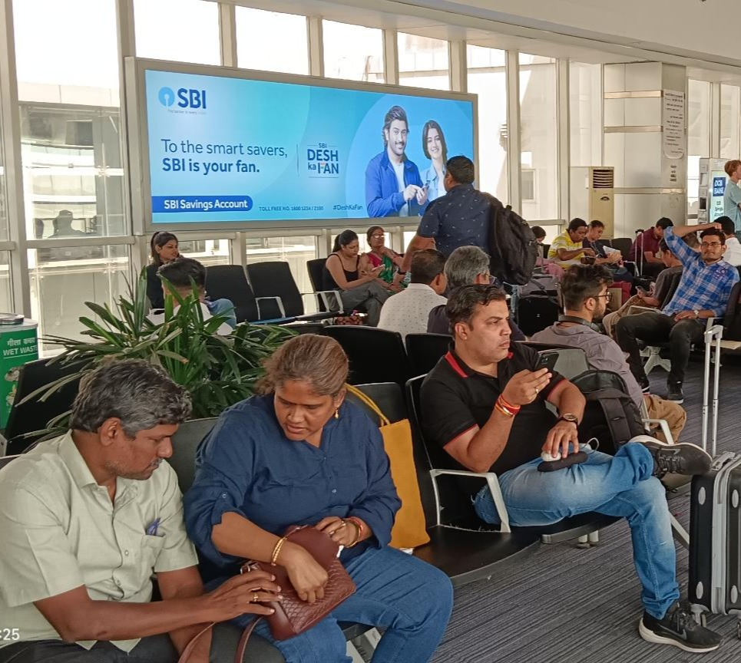


T2- DOMESTIC
Departure | Gate No.2 Seating Area | 14.7 W X 6.9 H ft (Only 1 Unit) | Back Lit
Static Lightbox Single Sided
www.themediaant.com
Notes:
‹#›

Slide 3
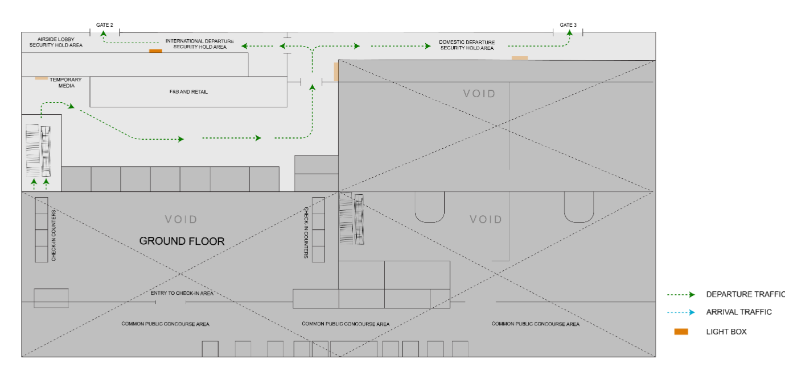
T2- DOMESTIC
Departure | Gate No.2 Seating Area | 14.7 W X 6.9 H ft (Only 1 Unit) | Back Lit
www.themediaant.com
Notes:
‹#›

Slide 4
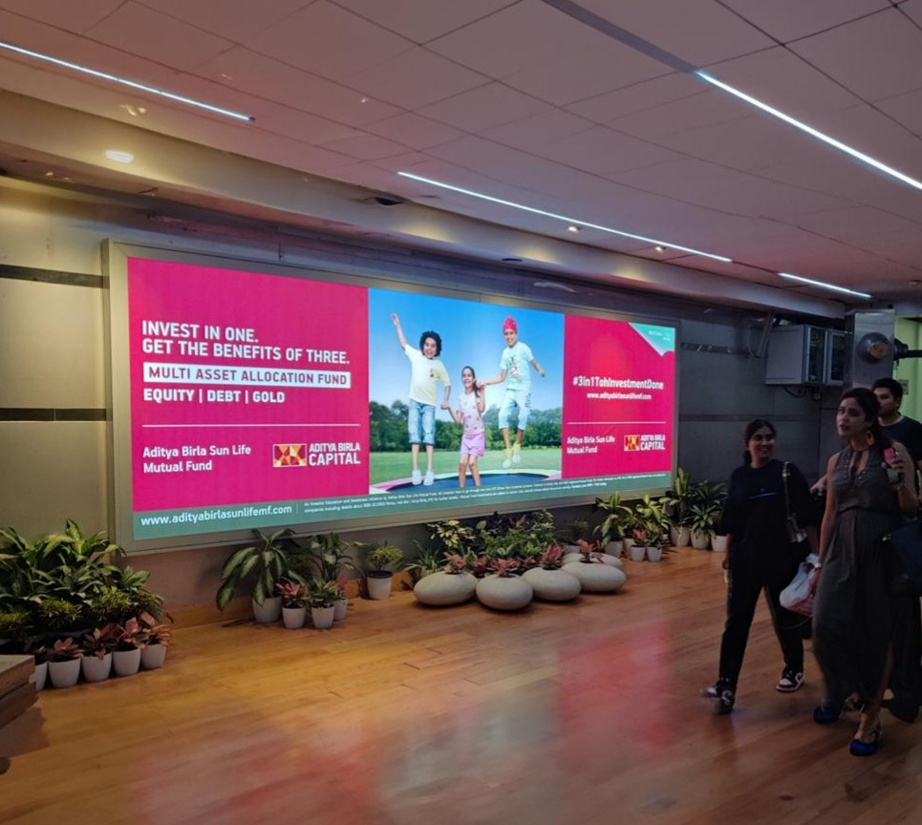
T2- DOMESTIC
Departure | Gate No.2 Seating Area | 14.7 W X 6.9 H ft (Only 1 Unit) | Back Lit
Static Lightbox Single Sided
www.themediaant.com
Notes:
‹#›

Slide 5
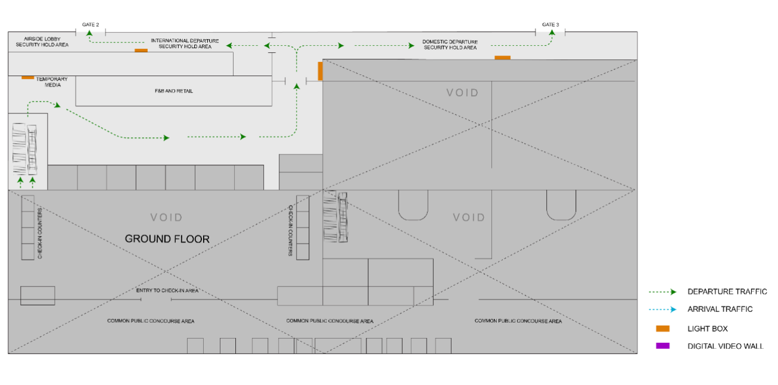
T2- DOMESTIC
Departure | Gate No.2 Seating Area | 14.7 W X 6.9 H ft (Only 1 Unit) | Back Lit
www.themediaant.com
Notes:
‹#›

Slide 6
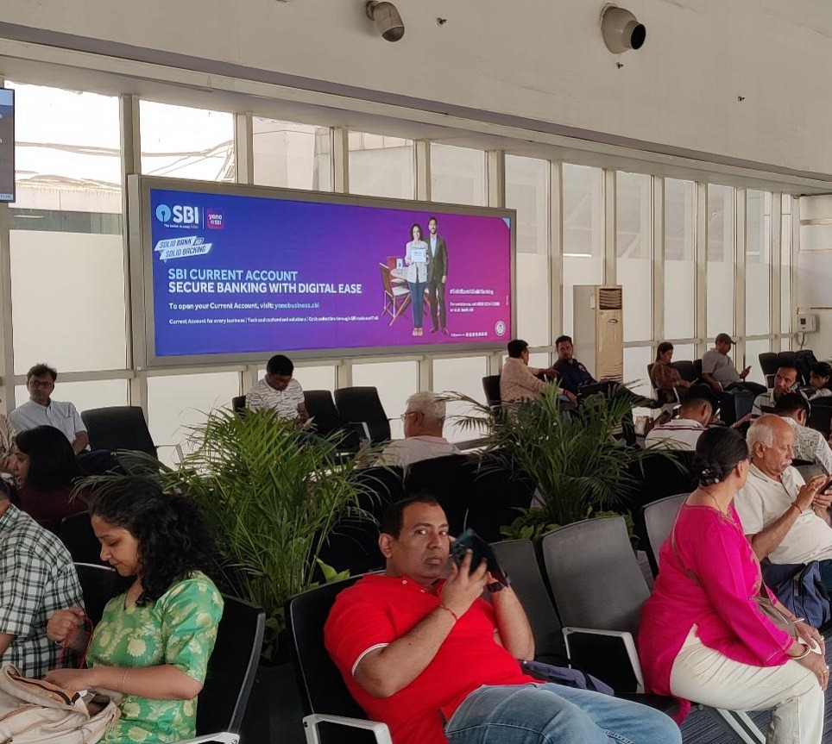
T2- DOMESTIC
Departure | Gate No.3 Seating Area | 14.7 W X 6.9 H ft (Only 1 Unit) | Back Lit
Static Lightbox Single Sided
www.themediaant.com
Notes:
‹#›

Slide 7
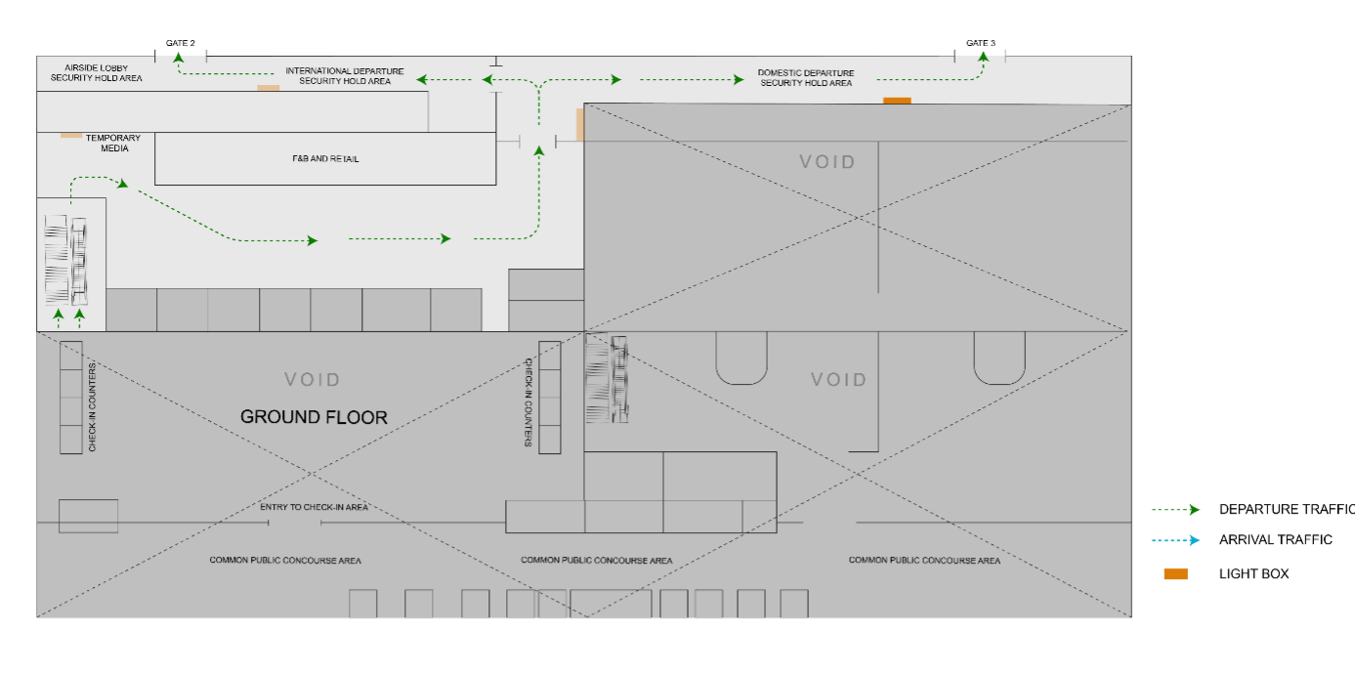
T2- DOMESTIC
Departure | Gate No.3 Seating Area | 14.7 W X 6.9 H ft (Only 1 Unit) | Back Lit
www.themediaant.com
Notes:
‹#›

Slide 8
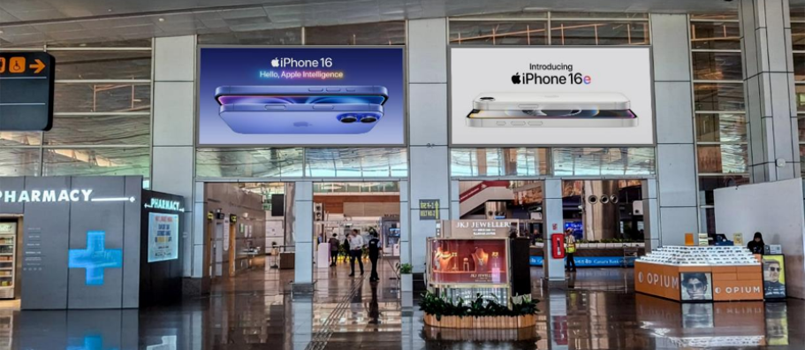
T2- DOMESTIC
Arrival | Arrival Hall | 20 W X 10 H ft (Package Of 2 Units) | Back Lit
Static Lightbox Single Sided
www.themediaant.com
Notes:
‹#›

Slide 9
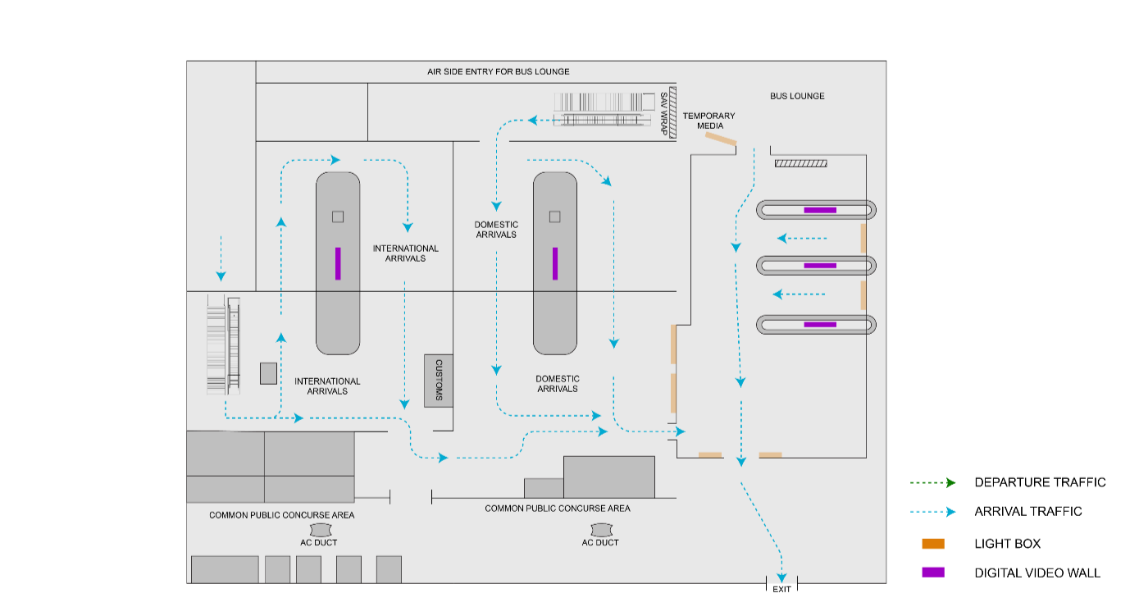
T2- DOMESTIC
Arrival | Arrival Hall | 20 W X 10 H ft (Package Of 2 Units) | Back Lit
www.themediaant.com
Notes:
‹#›

Slide 10





www.themediaant.com
ad@themediaant.com
Thank You
080-067415510
Empowering All To Advertise
Notes:
‹#›

