Slide 1

Lucknow Airport
Hoarding

Slide 2
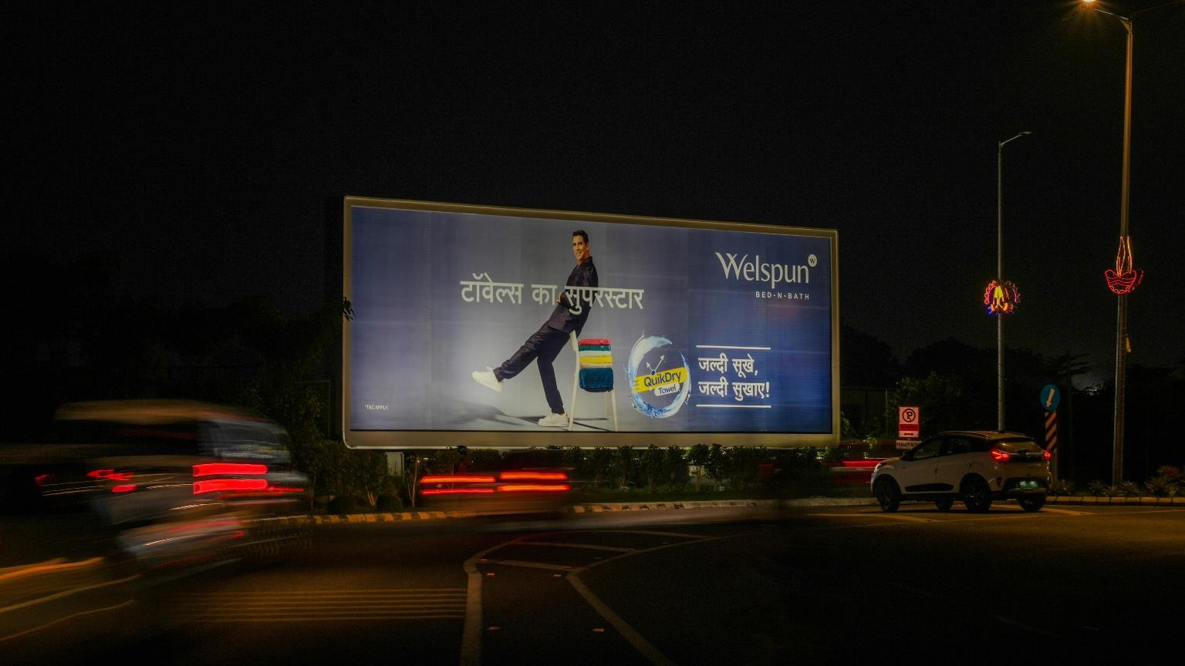



T3- DOMESTIC
Departure | Main Departure Road | 60 W X 20 H ft (Only 1 Unit) | Back Lit
Hoarding
www.themediaant.com
Notes:
‹#›

Slide 3
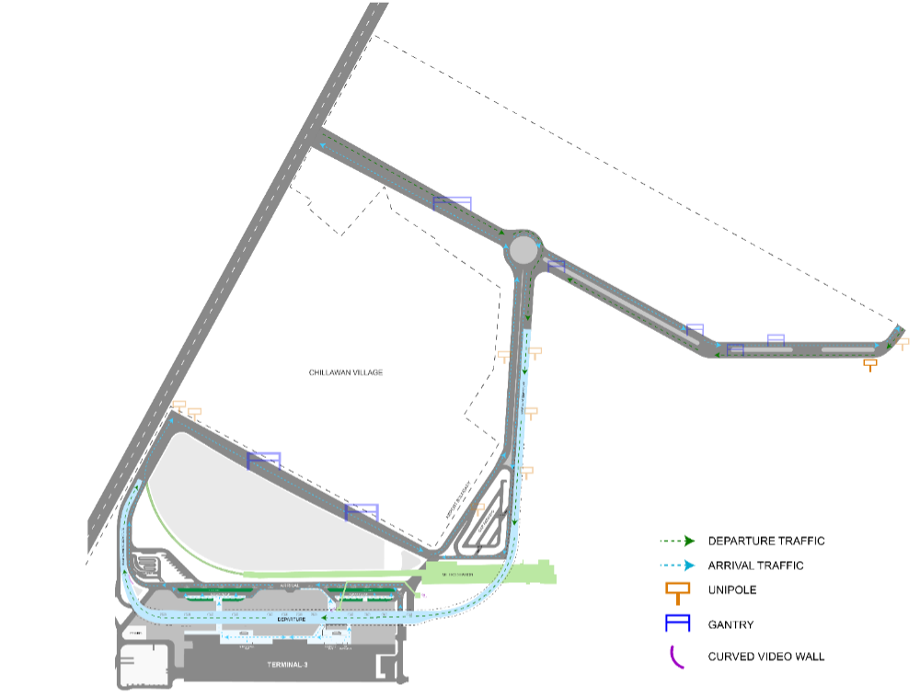
T3- DOMESTIC
Departure | Main Departure Road | 60 W X 20 H ft (Only 1 Unit) | Back Lit
www.themediaant.com
Notes:
‹#›

Slide 4
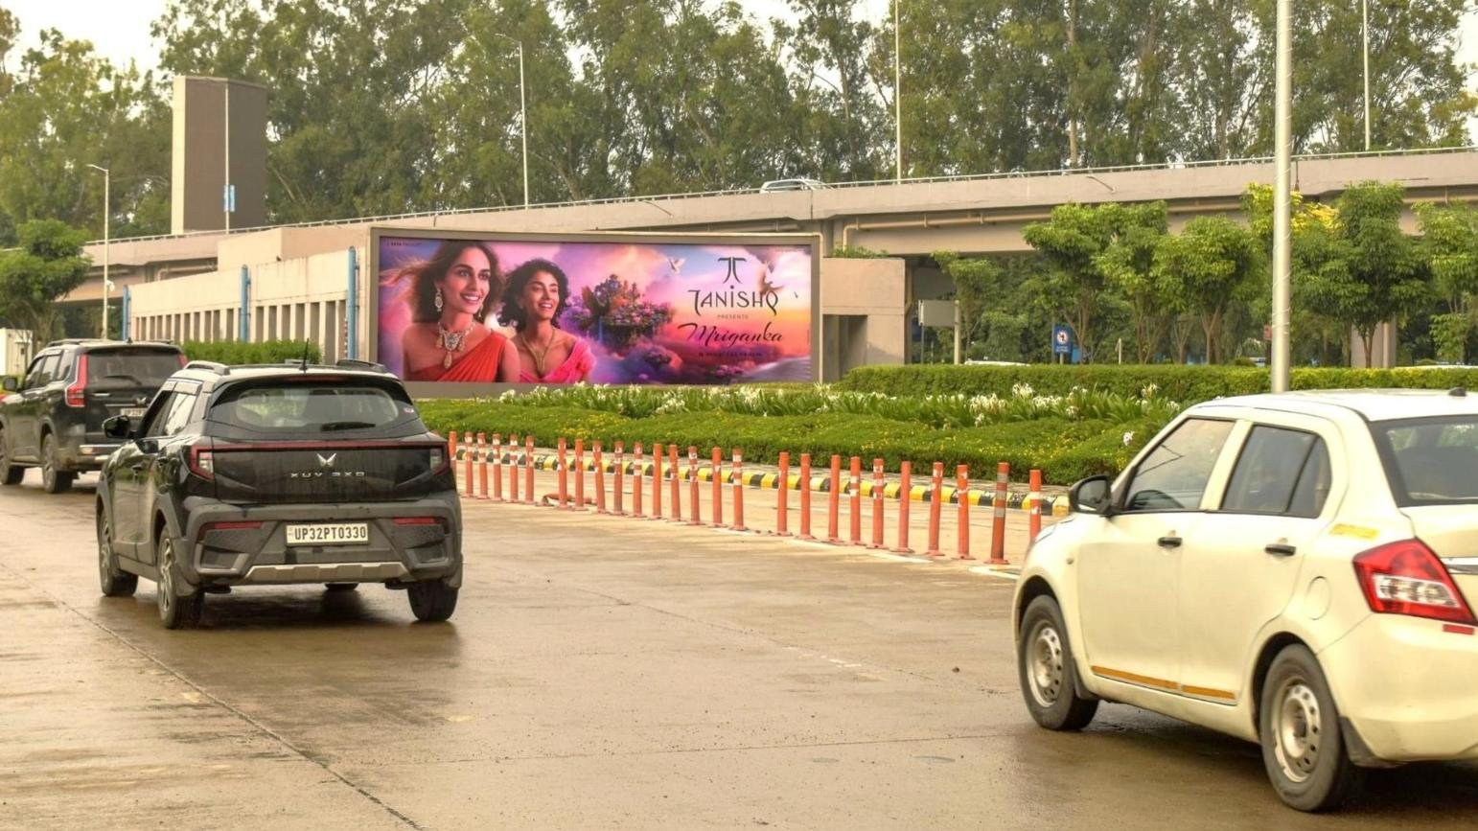
T3- DOMESTIC
Arrival | Arrival Exit Lane | 30 W X 10 H ft (Only 1 Unit) | Back Lit
Hoarding
www.themediaant.com
Notes:
‹#›

Slide 5
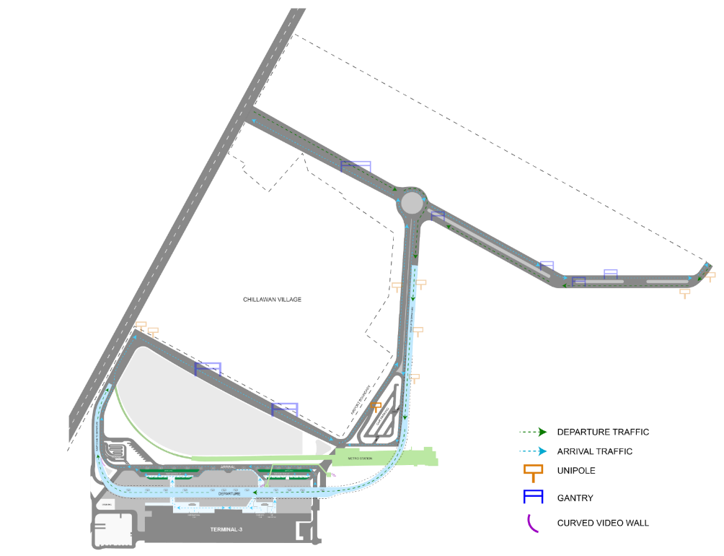
T3- DOMESTIC
Arrival | Arrival Exit Lane | 30 W X 10 H ft (Only 1 Unit) | Back Lit
www.themediaant.com
Notes:
‹#›

Slide 6
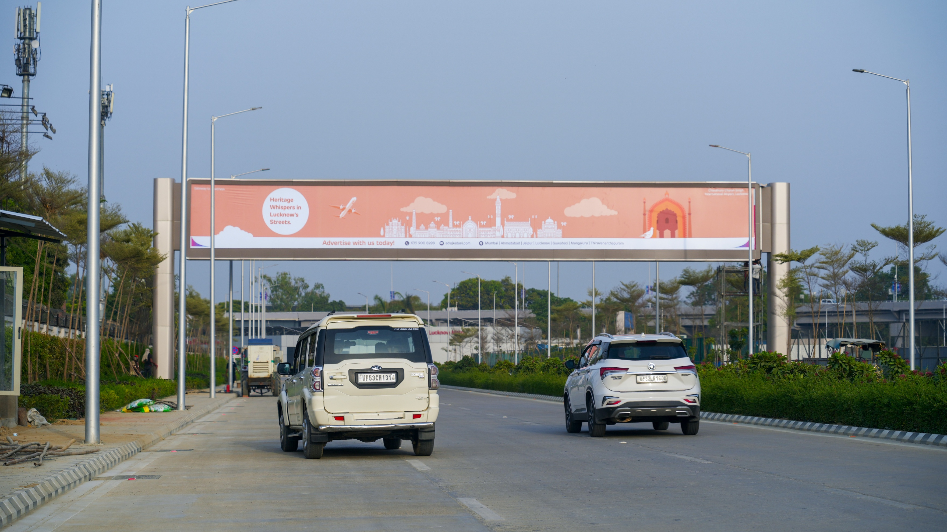
T3- DOMESTIC
Arrival | Outdoor Arrival Road | 85 W X 10 H ft (Only 1 Unit) | Back Lit
Hoarding
www.themediaant.com
Notes:
‹#›

Slide 7
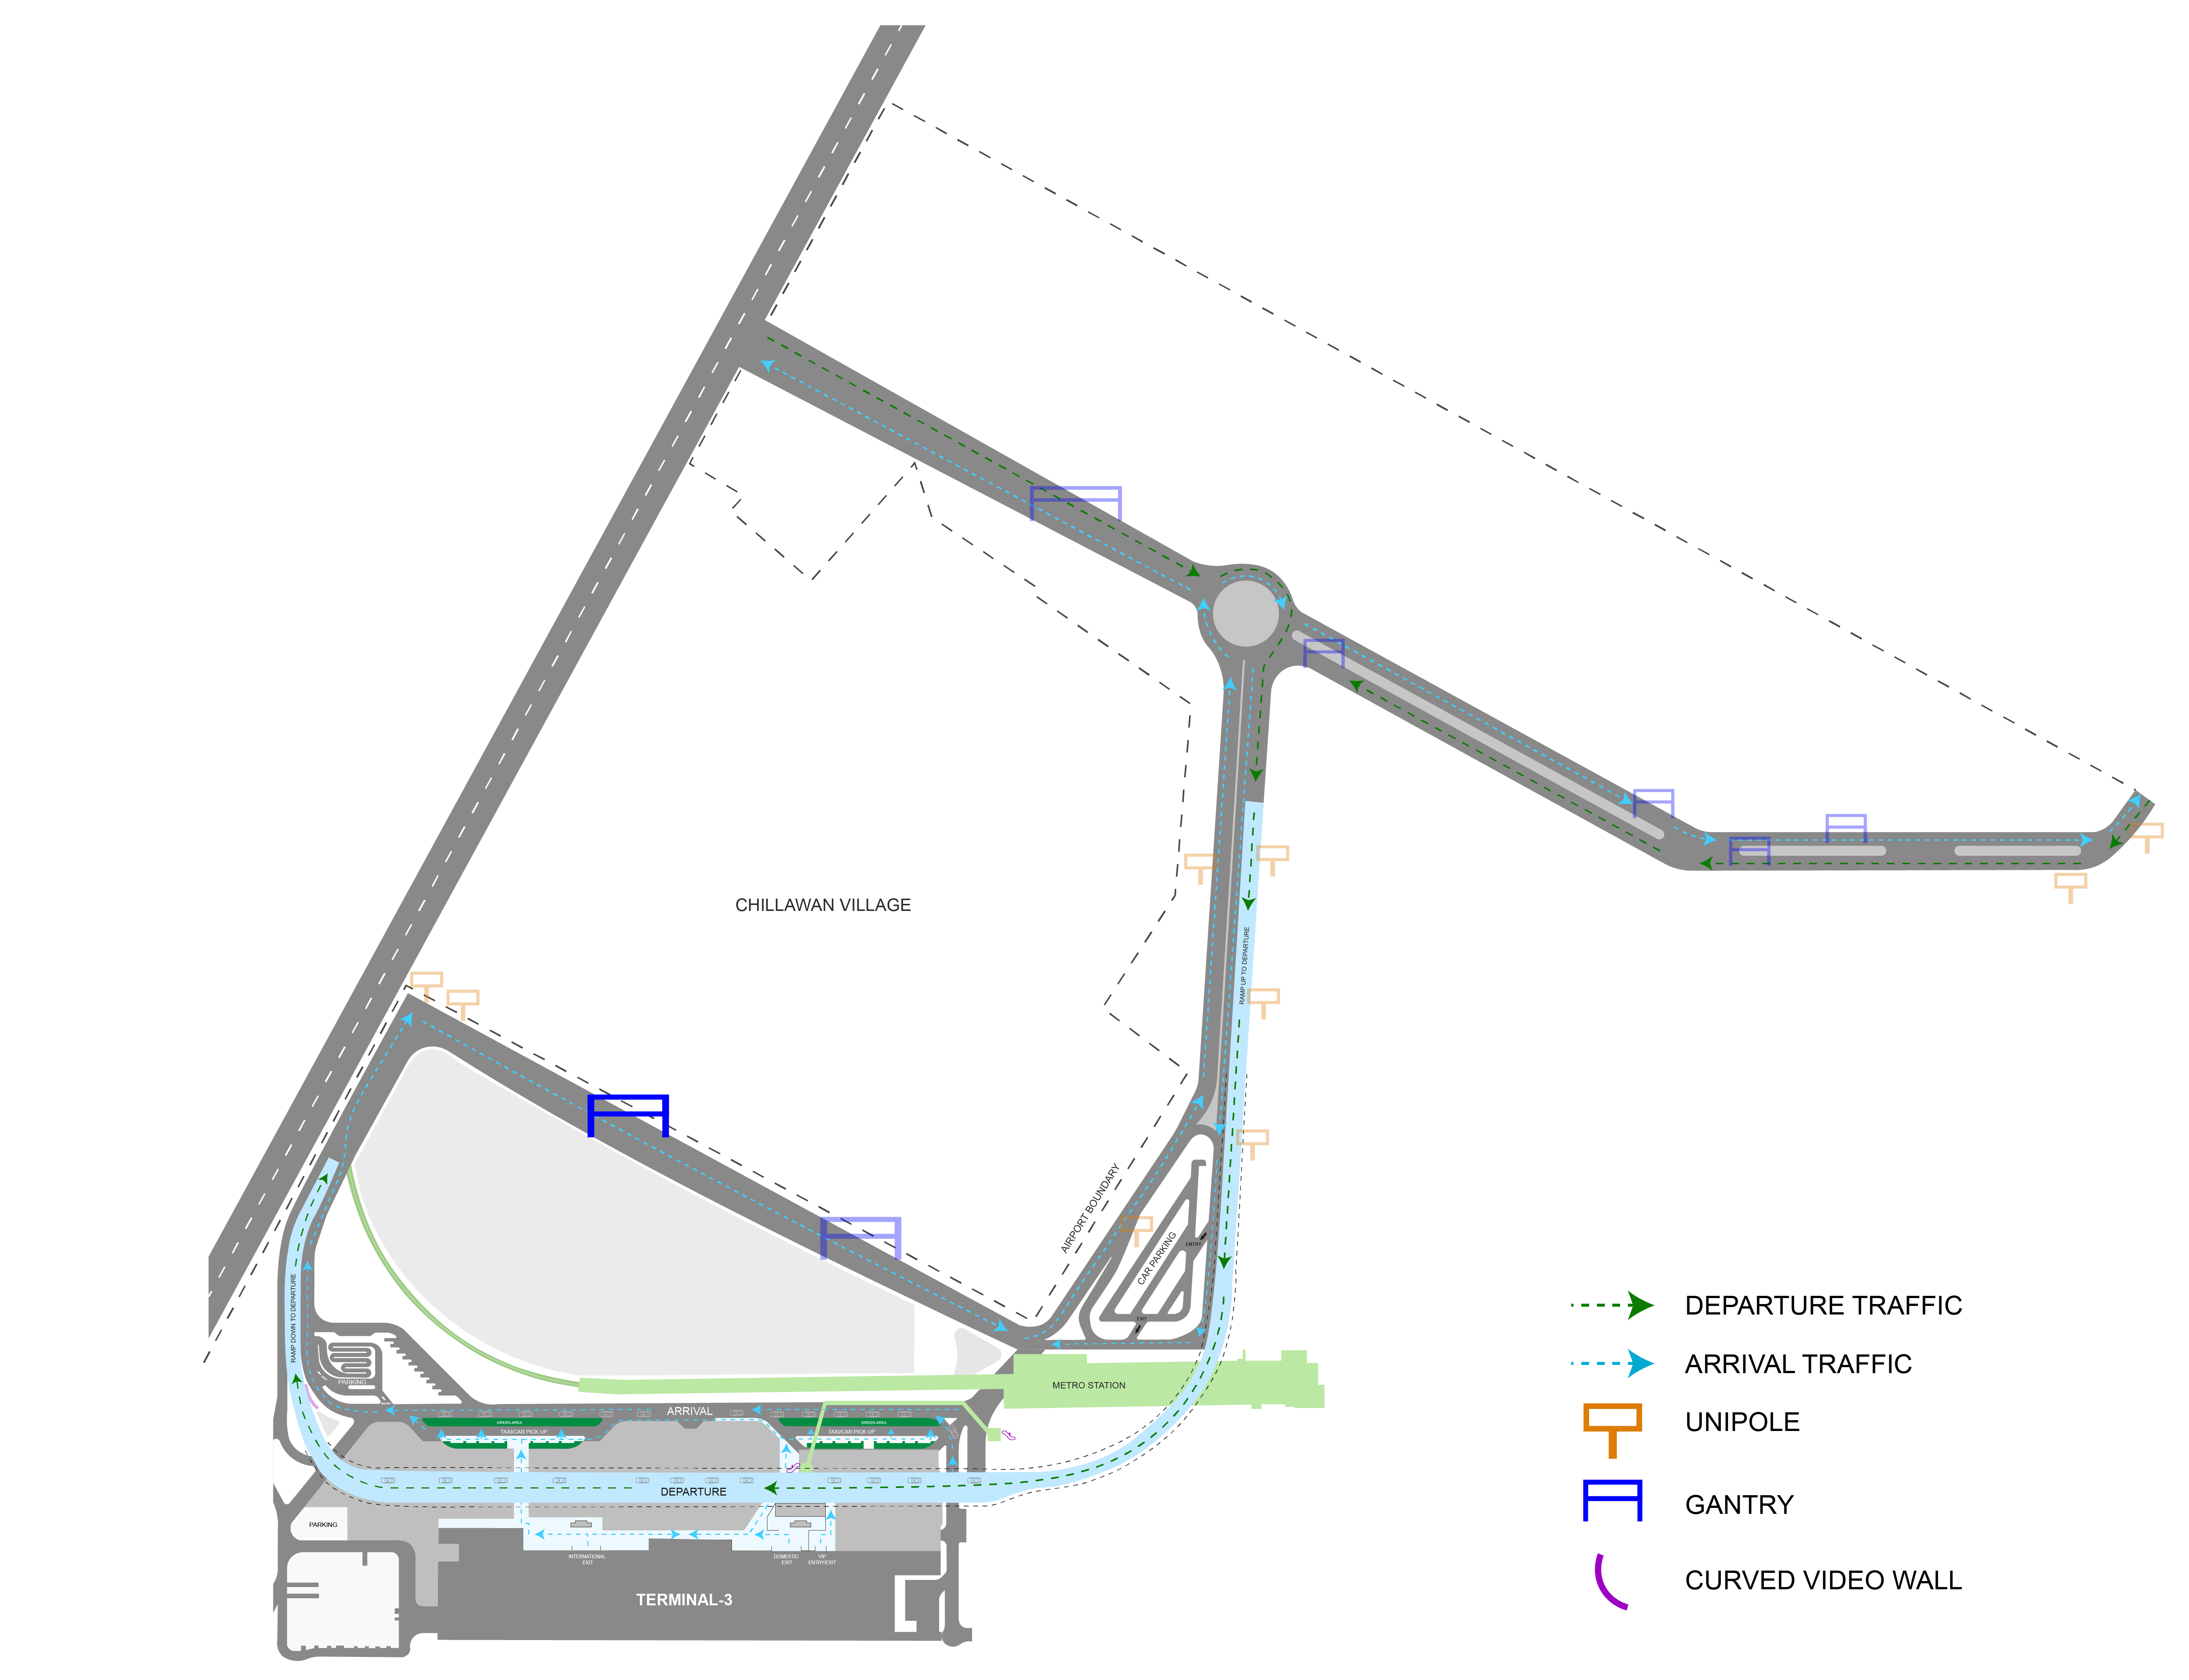
T3- DOMESTIC
Arrival | Outdoor Arrival Road | 85 W X 10 H ft (Only 1 Unit) | Back Lit
www.themediaant.com
Notes:
‹#›

Slide 8





www.themediaant.com
ad@themediaant.com
Thank You
080-067415510
Empowering All To Advertise
Notes:
‹#›

